Slide 1

Lecture 1.3 – Course Introduction
GPU Teaching Kit
Accelerated Computing
Portability and Scalability in Heterogeneous Parallel Computing

Slide 2
Objectives
To understand the importance and nature of scalability and portability in parallel programming

Slide 3
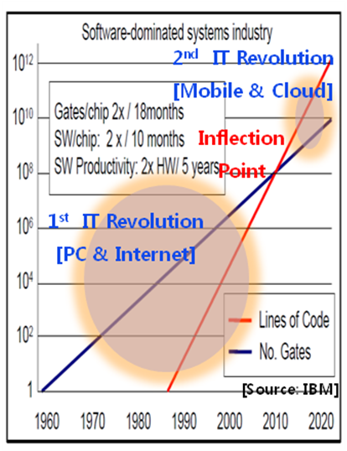
Software Dominates System Cost
SW lines per chip increases at 2x/10 months
HW gates per chip increases at 2x/18 months
Future systems must minimize software redevelopment

Slide 4
Keys to Software Cost Control
Scalability
App
Core A

Slide 5
Keys to Software Cost Control
Scalability
The same application runs efficiently on new generations of cores
App
Core A 2.0

Slide 6
Keys to Software Cost Control
Scalability
The same application runs efficiently on new generations of cores
The same application runs efficiently on more of the same cores
App
Core A
Core A
Core A

Slide 7
More on Scalability
Performance growth with HW generations
Increasing number of compute units (cores)
Increasing number of threads
Increasing vector length
Increasing pipeline depth
Increasing DRAM burst size
Increasing number of DRAM channels
Increasing data movement latency
The programming style we use in this course supports scalability through fine-grained problem decomposition and dynamic thread scheduling

Slide 8
Keys to Software Cost Control
Scalability
Portability
The same application runs efficiently on different types of cores
App
App
App
Core B
Core A
Core C

Slide 9
Keys to Software Cost Control
Scalability
Portability
The same application runs efficiently on different types of cores
The same application runs efficiently on systems with different organizations and interfaces
App
App
App

Slide 10
More on Portability
Portability across many different HW types
Across ISAs (Instruction Set Architectures) - X86 vs. ARM, etc.
Latency oriented CPUs vs. throughput oriented GPUs
Across parallelism models - VLIW vs. SIMD vs. threading
Across memory models - Shared memory vs. distributed memory

Slide 11

GPU Teaching Kit
Accelerated Computing
The GPU Teaching Kit is licensed by NVIDIA and the University of Illinois under the Creative Commons Attribution-NonCommercial 4.0 International License.

